Slide 1
Orchestration and AIOps
Damian A. Tamburri, Ph.D.

Slide 2
Course Structure in Blocks
YOU ARE HERE!
Bugs
Smells
Clones
TDebt
Basics
Intro
Major Causes of Maintenance Problems
Domain & Tech. specific Maintenance & Evolution
Org. & Managerial Issues
Major Subjects of
Evolution Activities
Teams
Patterns
AIOps
Smells
MLOps
IaC
µS
Req.s
Arch.s
Systems
Infra.
DevOps

Slide 3
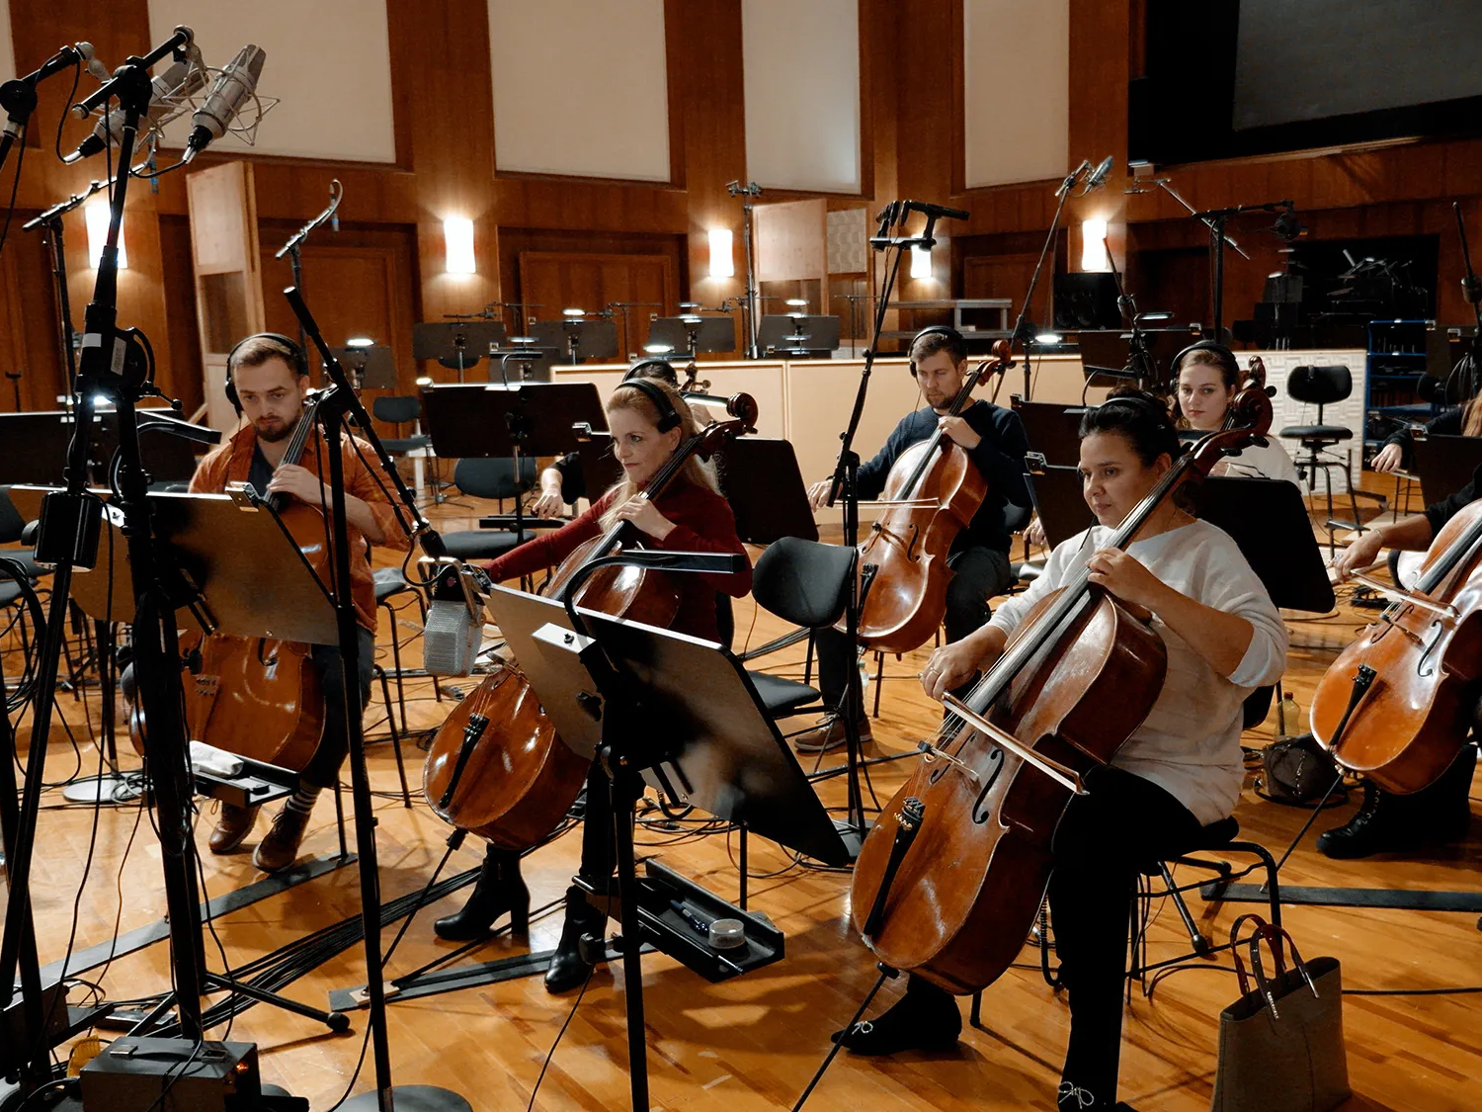

Slide 4
Service-oriented architecture (SOA)
Service
Description
Service
Registry
Find
Publish
Service
Requestor
Service
Provider
Service
Bind
Service
Description

Slide 5
SOA – Operational pros and cons
Pros
  Enables reuse across organizational boundaries
  Introduces the idea of services offered through a well-defined API
  Relies on runtime discovery and dynamic binding
Cons
  The emphasis on lack of ownership was pushed to the extreme
  The idea of a universal discovery engine (UDDI) was not well accepted
  SOAP was considered too heavyweight as a protocol
  People emphasized too much the need for defining glue code as business processes as opposed to providing guidelines on how to write services
Microservices can be seen as a specific instantiation of SOA focusing on decomposition and enhancing low coupling

Slide 6
Microservice architectural style
...the microservice architectural style is an approach to developing a single application as a suite of small services, each running in its own process and communicating with lightweight mechanisms, often an HTTP resource API
- Martin Fowler

Slide 7









The starting point for microservices: monolithic architectures
Load Balancer
Monolithic App
Account Component
Catalog
Component
Database
Recommendation
Component
Customer Service
Component

Slide 8
Big problems (1/2)
Intimidate developers
Obstacle frequent deployments
  Need to redeploy everything to change one component
  Interrupt long running background jobs
  Increase risk of failure
Overload IDEs and containers
Obstacle to scaling development
Require long-term commitment to a technology stack

Slide 9
Big problems (2/2)
Scaling is “undifferentiated”
  It is not possible to scale “Product Catalog” differently from “Customer Service”
Availability
  A single missing “;” brought down the Netflix website for many hours (~2008)

Slide 10
Microservices key benefits: technology heterogeneity
Each service can be implemented on its own technology stack
  Technology stack can be selected to fit the task best
  Teams can also experiment with new technologies within a single microservice
Advantages
  No struggle to push for your technology
  No piggy-pack dependencies to unnecessary technologies or libraries
Posts
<<Ruby>>
Friends
<<Go>>
Pictures
<<Java>>
Document store
Graph DB
Blob store

Slide 11
Microservices key benefits: resilience
If a microservice fails the others can still work, possibly with a degraded functionality
Note: building a distributed system per se can introduce new types of failures related to network and communication

Slide 12
Microservices key benefits: scaling
Each microservice can be scaled independently
Identified bottlenecks can be addressed directly
  Parts of the system that do not represent bottlenecks can remain simple and un-scaled
Pictures
Instance 1
Instance 2
Instance 3
Posts
Instance 4
Instance 5
Instance 6
Instance 1
Instance 2
Instance 3
Friends
Instance 1
Instance 2

Slide 13
Microservices key benefits: independent codebases and easy of deployment
Each service has its own software repository
  Codebase is maintainable for developers
  It fits into their brain
No accidental cross-dependencies between codebases
Tools work faster
  Building, testing, refactoring code takes seconds
Each service can be deployed independently of the others
Startup only takes seconds

Slide 14
Microservices key benefits: reuse and composability
The functionality offered by a microservice can be used and reused in multiple contexts
It is possible to compose multiple microservices in different ways

Slide 15
Microservices key benefit: replaceability
Monolithic systems are often so big and complex that their replacement is risky and costly
Given its small size, replacing a microservice implementation is much easier
  The team can develop a new implementation
  As soon as the service is ready for operation, it can be moved in the operational environment
  The previous service can be shutdown

Slide 16
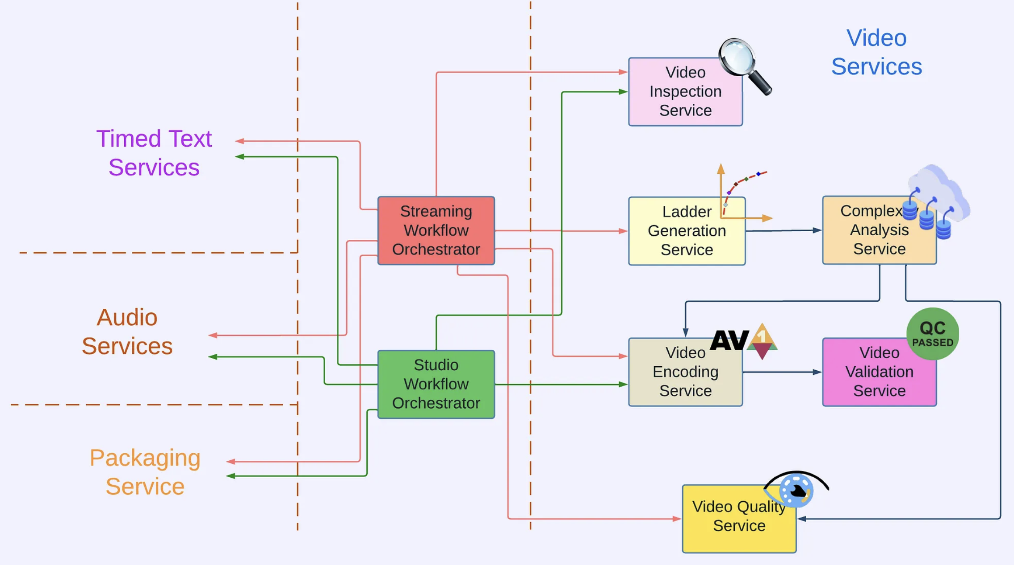
µS at Netflix!

Slide 17
Evolution at NETFLIX
2008
Old DataCenter
Everything in one WebApp
~2010
AWS Cloud
100s of fine-grained Services

Slide 18
MODERN Scale at NETFLIX
30% of the Internet traffic
500+ microservices
2+ billion API gateway requests daily
Each API call requires average six calls to backend services
Over 800 different client devices

Slide 19
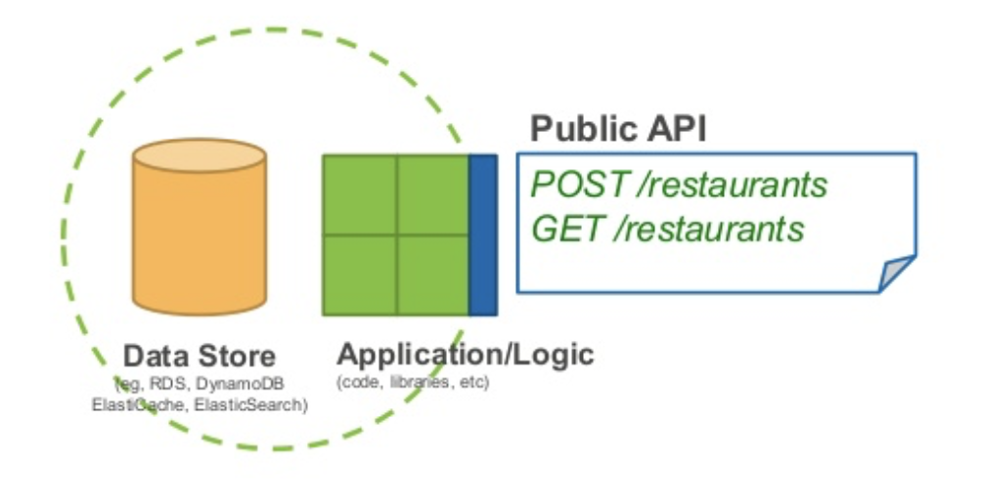
Anatomy of a microservice

Slide 20
Language Landscale

Slide 21
Critical issues with microservice architectures
We deal with distributed systems
Aspects to be taken care of
  Careful identification of microservices
  Communication, integration and distributed transactions
  Careful definition of the guiding principles and practices for the microservice architecture
  Deployment
  Testing
  Monitoring

Slide 22
The build pipeline
Possible deployable artifacts
  Platform-specific, e.g., JAR/WAR, jems, eggs, …
  OS-specific, e.g, RPM
  Images (also ensure that deployed services cannot be modified on the fly)

Slide 23
Multiservice vs single service per host deployment
service
service
service
service
host
host
service
service
service
service
host
host
host
Requires more resources
Makes scalability easier and even
Various mechanisms available for host virtualization

Slide 24
Possible container technology - Docker

Slide 25
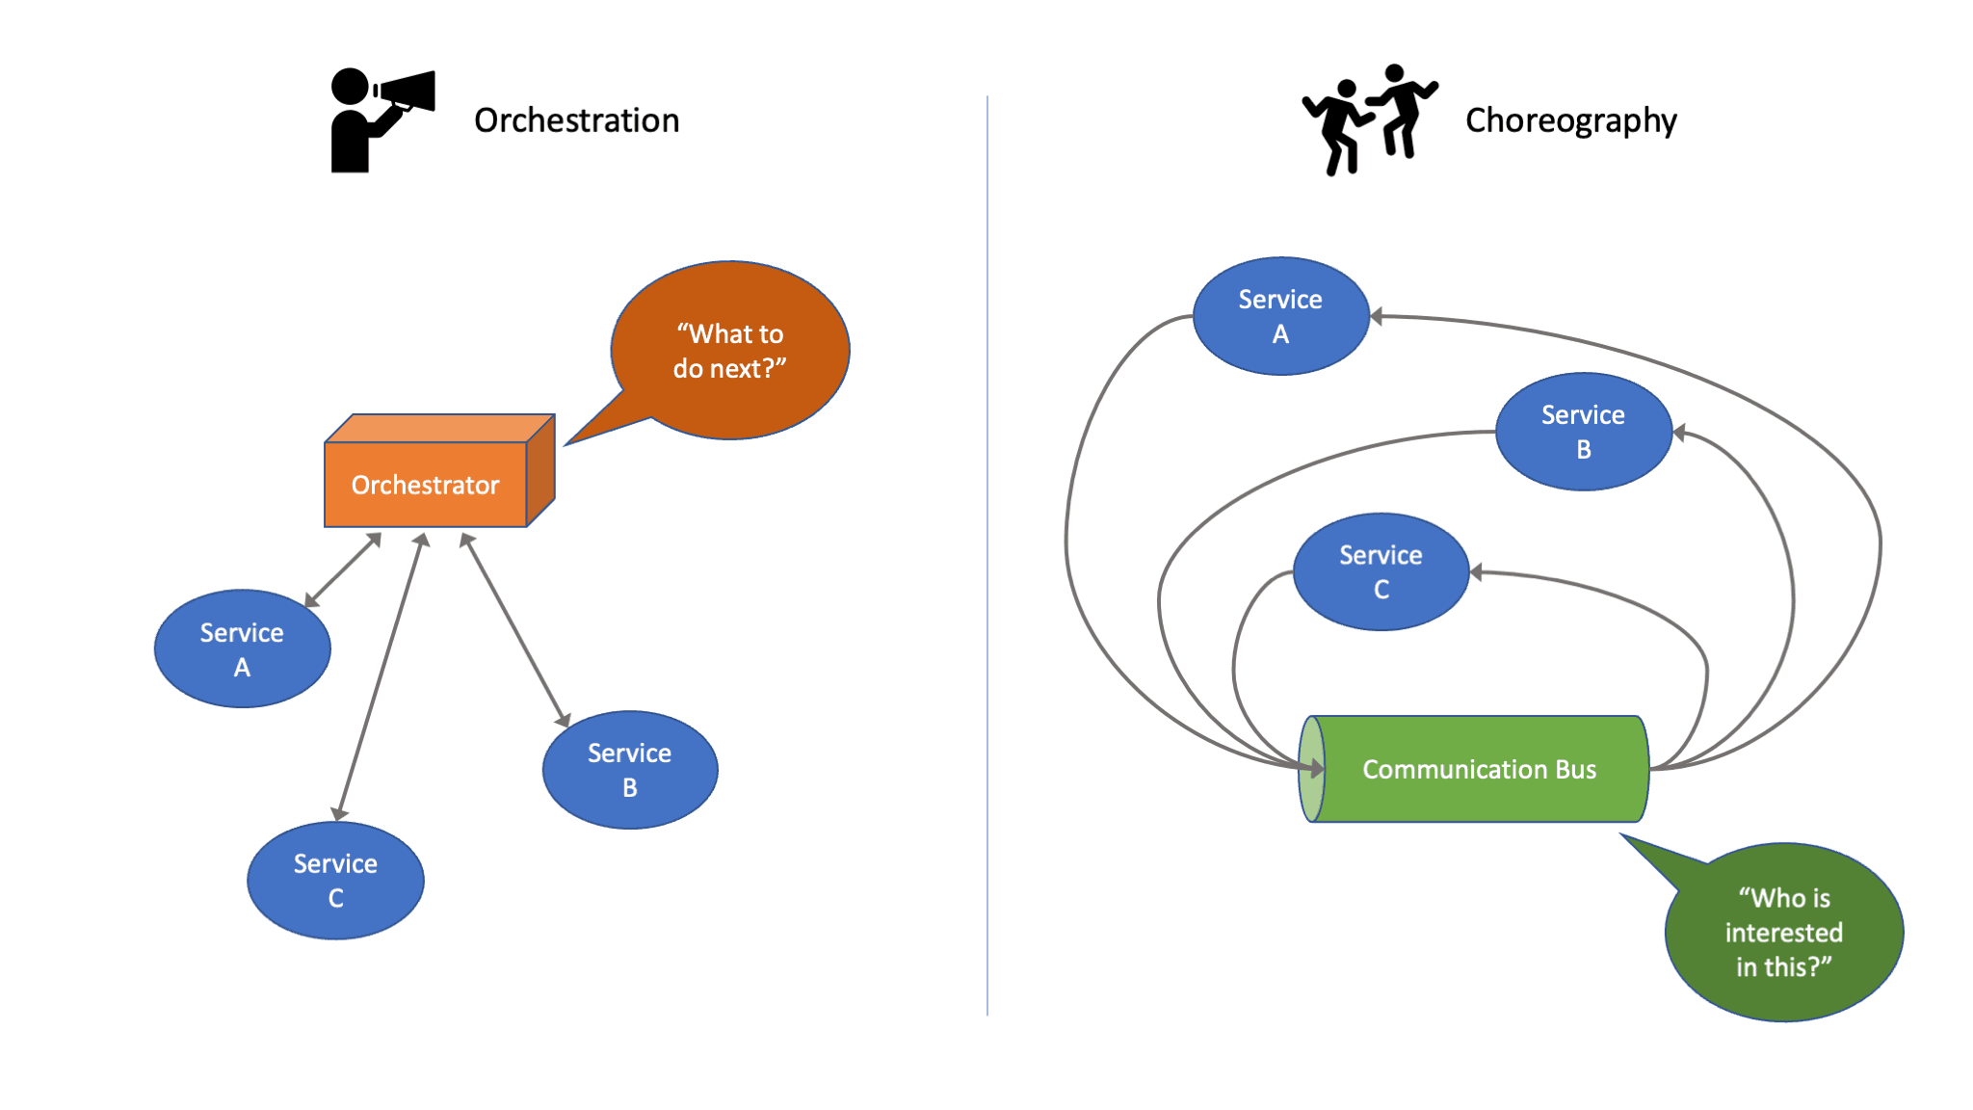
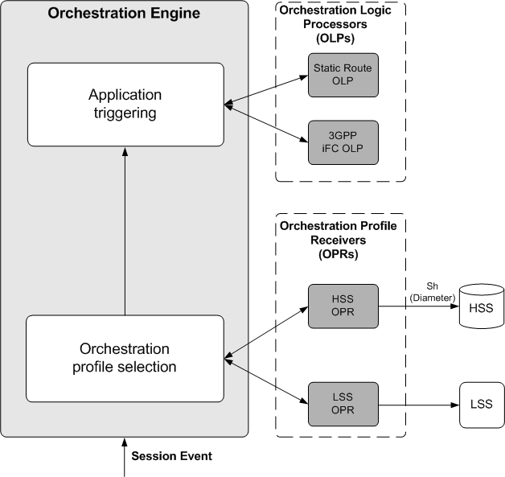
Orchestration Explained
The process of arranging and managing all of the above…
  ORCHESTRATION!
The machine that arranges for orchestration…
  ORCHESTRATOR!

Slide 26
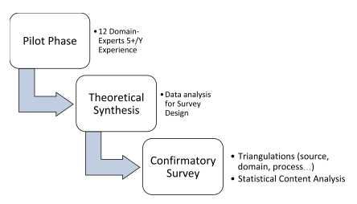
What happens During Orchestration*?
* Damian A. Tamburri, Marco Miglierina, Elisabetta Di Nitto, Cloud applications monitoring: An industrial study, Information and Software Technology, Volume 127, 2020, 106376, ISSN 0950-5849.

Slide 27
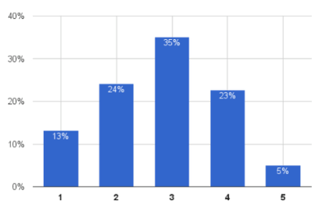
Level of Automation
* Damian A. Tamburri, Marco Miglierina, Elisabetta Di Nitto, Cloud applications monitoring: An industrial study, Information and Software Technology, Volume 127, 2020, 106376, ISSN 0950-5849.

Slide 28
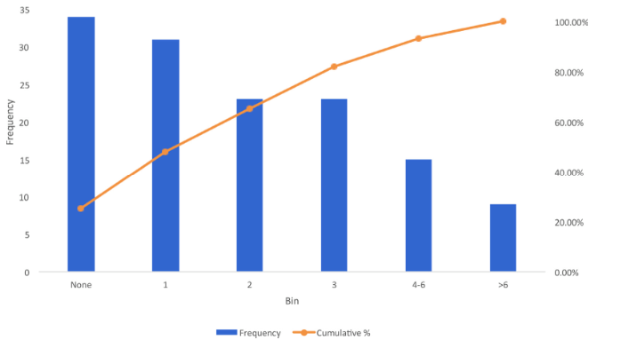
Numbers of tools in Pipeline

Slide 29
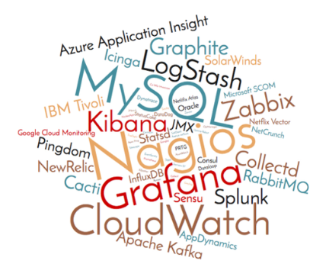

Slide 30
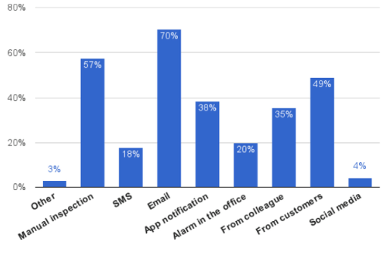
Alert Distribution Mechanism

Slide 31


Slide 32
AI-Driven Service Operations ➔ AIOps!

Slide 33




What is AIOps?
AIOps combines big data and machine learning to automate IT operations processes, including event correlation, anomaly detection and causality determination.
Software that applies AI/ML or other advanced analytics to business and operations data to make correlations and provide prescriptive and predictive answers in real time.
AIOps broadly is any tool in the monitoring and incident-response tool chain that uses machine learning technology.
The application of analytic capabilities (i.e., ML, AI, NLP, etc.) on IT operations data sources to automatically solve specific operational challenges, often describing, diagnosing, or recommending a course of action to allow IT to be more proactive.
Notes:
So What is AIOps? Depends on Who You ask… And this is why we have a unique opportunity. Unlike ITSM and ITIL or Cobit foundations, there is no strict definition of AIOps. We get to decide what it means and how to best make it fit for our clients. So what is our definition?

Slide 34

Operationalising AIOps
Accelerated Root Cause Identification
On-Call
Management
AIOps
IT Ops
SecOps
Work, Data, Customer Signals
and Events
Event Management
Human Mobilization
Event Driven Automation
Automated
Incident Response
DevOps
Business Ops
(HR, Legal, Sales, etc)
Automated Diagnostics
Automated Resolution
Automation
Customer Service Ops
Critical Event
Management

Slide 35


Digital Transformation is Hard
Teams are under pressure to deliver
Inundated
by alert noise
69% of DevOps and ITOps teams are struggling with an increase in alert noise on a
daily basis
Confused about where & what
59% say finding the root cause of issues has become harder due to app and infrastructure monitoring complexity
Wasted time
in manual tasks
47% say manual processes and response plays to P1 (business critical) incidents hampers productivity
Reduce noise
Reduce time to resolution
Remove toil
Source: Digital Pressures in 2020: 2020/21 Global Developer and IT Operations Report

Slide 36
A Needed Approach to AIOps
Easy to
Get Started
No
Slowdown
No
Data Scientists
The Action in Actionable Intelligence
We need low friction to quickly see results and show value to stakeholders
Fits centralized and decentralized teams, leverage our existing tooling
Can’t rely on complex setup or data lakes of information for Ops to begin now
AI and Machine Learning may provide assistance, but we need the “What Next?” when it’s time to resolve incidents
Notes:
We really need a different way of doing this:
First, it has to be simple, low friction easy to pop in and get going and Oh, by the way, you can't slow down.
Everyone is too busy running, it has to be as easy as possible to solve these tactical problems while building strategic solutions.
We can't invest valuable data scientists that are looking at customer data to come in and help drive in our it environments. They're going to be focused on how do we make more money, how do we become more competitive.
But in the end, the real difference is being able to help with that “what next?” - how do we actually help solve the problem, so driving that action and actionable intelligence is something that we look at in a different way, because

Slide 37
MTTR != Mean Time to Root Cause
MTTR = Mean Time to Resolve.

Slide 38

The True Value of AIOps
IT Service Management (ITSM) Metrics: Availability, MTTA, MTTR, MTTBF, First Touch Resolution, etc.
DevOps Research & Assessment (DORA) Metrics: MTTR, Change Failure Rate
“By 2024, 25% of traditional large enterprise CIOs will be held accountable for digital business operational results, effectively becoming COO by proxy.”
Gartner
Which of these business outcomes are you responsible for?
Development Metrics: Technical Debt, Feature Queues, Developer Productivity, Developer Turnover, Employee Satisfaction, etc.
Customer Metrics: Customer Experience, Customer Satisfaction, Net Promoter Scores, etc.
Team Health: Reduced Burnout, Higher Morale, Better Alignment,
and Balance of Work

Slide 39

Lifecycle of an Incident
Human
Response
Probable Cause Analysis
RESOLVED!
Noise reduction
Event Enrichment, Routing, and Automation
Machine
Response

Slide 40
AIOps Must Scale and Build Resilience
Event-Driven
Automation-First
People-Centric
Self-Service
Democratizes Data & Action
Deliver Data-Driven Decisions
MAKE YOU MORE PRODUCTIVE!

Slide 41
Sample AIOps: Earthdata CloudOps
AIOps:
  Artificial Intelligence for Information Technology (IT) Operations
The application of artificial intelligence and machine learning (AI/ML) techniques to improve operations outcomes for IT systems
Earthdata CloudOps is the datalake for NASA & ESA; feat. Everything from
cloud operations to space monitoring.

Slide 42
Problem Statement
Earth Science IT systems have increasing:
  Scale
  Complexity
  Diversity
  Inter-Dependence
Operations Teams and System Administrators face an increasing challenge keeping systems online, performant, cost efficient, and secure

Slide 43
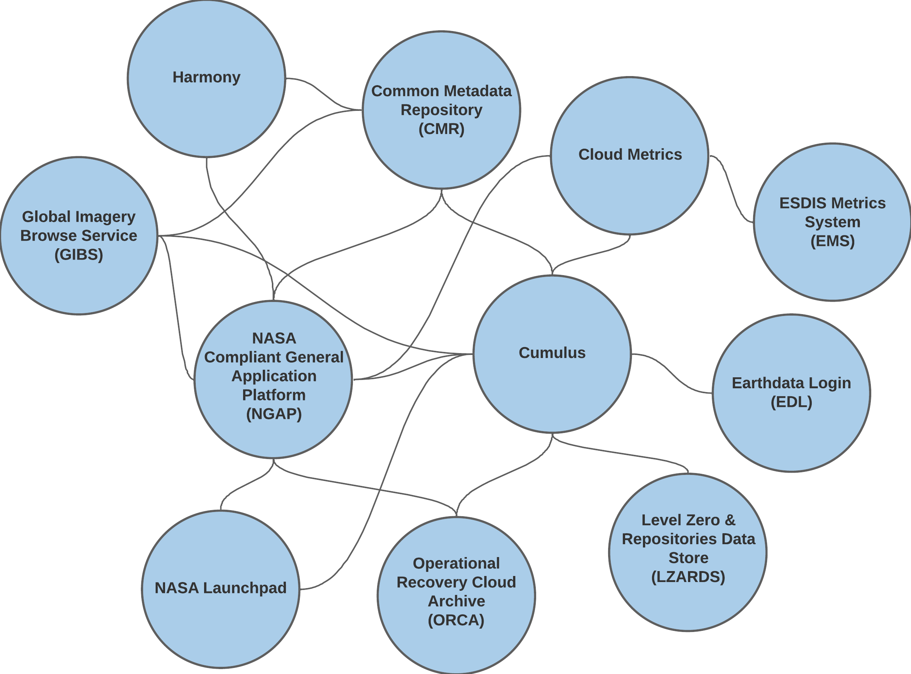
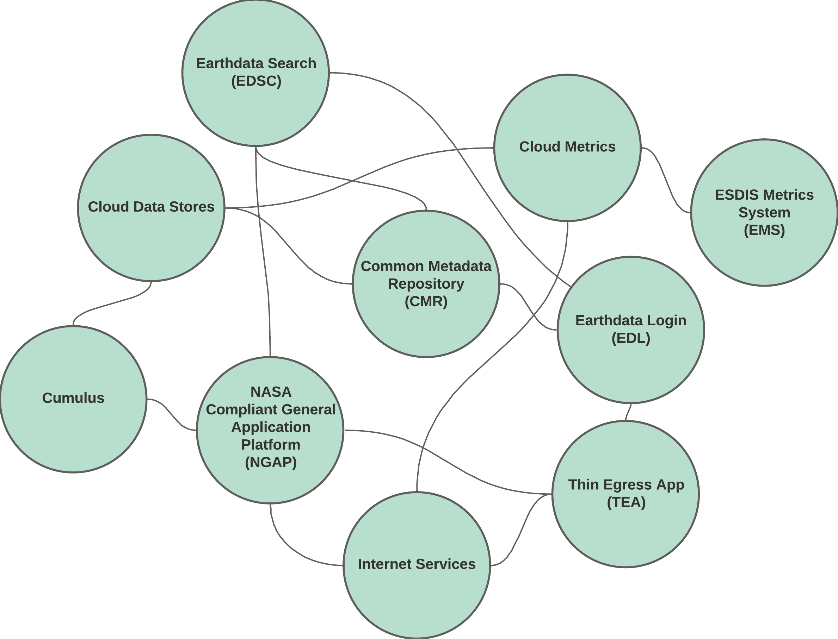

Earthdata Cloud: Key Systems
Mission Data Ingest*
Mission Data Distribution*
* woefully non-comprehensive summary
Image Source: NASA / GSFC Ben Williams
Image Source: NASA / GSFC Ben Williams
“Hey, there’s something up with [ ingest | distribution ] !?”

Slide 44
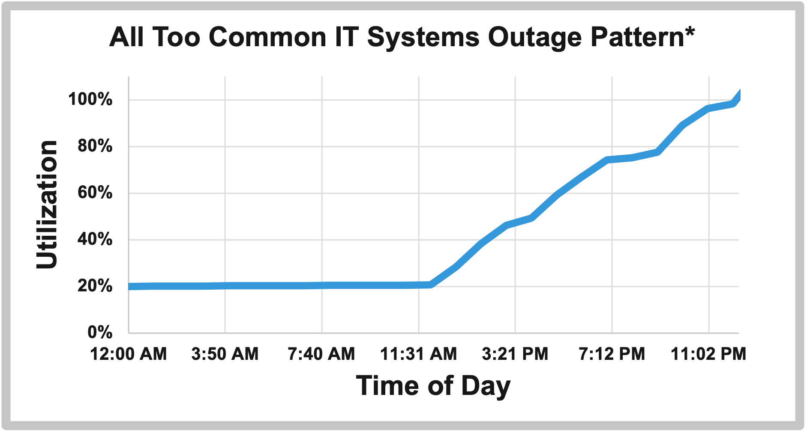
Traditional Approach
Logs and Metrics Collection
Pre-defined Alert Thresholds
Basic Operator Dashboards
*Fabricated example – no admins were harmed in the making of this chart
Image Source: NASA / GSFC Ben Williams

Slide 45
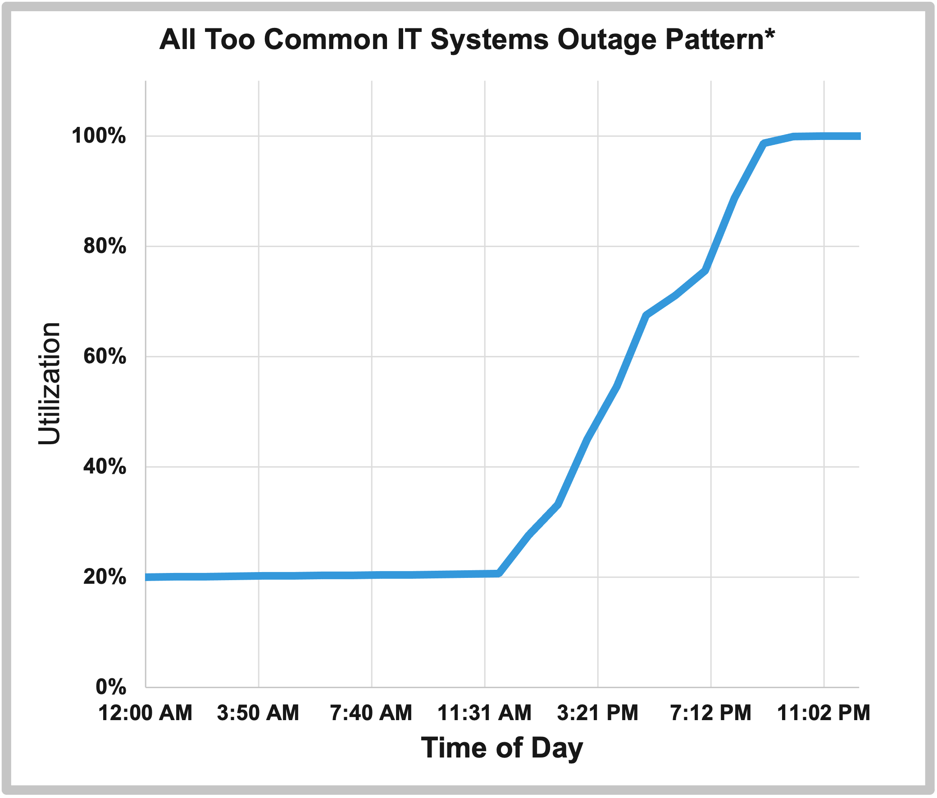
Traditional Approach
Fabricated Outage Timeline
11:30AM:
change deployed to production
3:30PM:
post-deployment system checks all show nominal status
9:00PM:
90% utilization alert triggered.
On-call admin notified
10:00PM:
system froze due to resource exhaustion
10:30PM:
on-call admin begins investigation
1:00AM:
Admin repairs resource overrun.
System resumes normal operation
*Fabricated example – no admins were harmed in the making of this chart
Image Source: NASA / GSFC Ben Williams

Slide 46
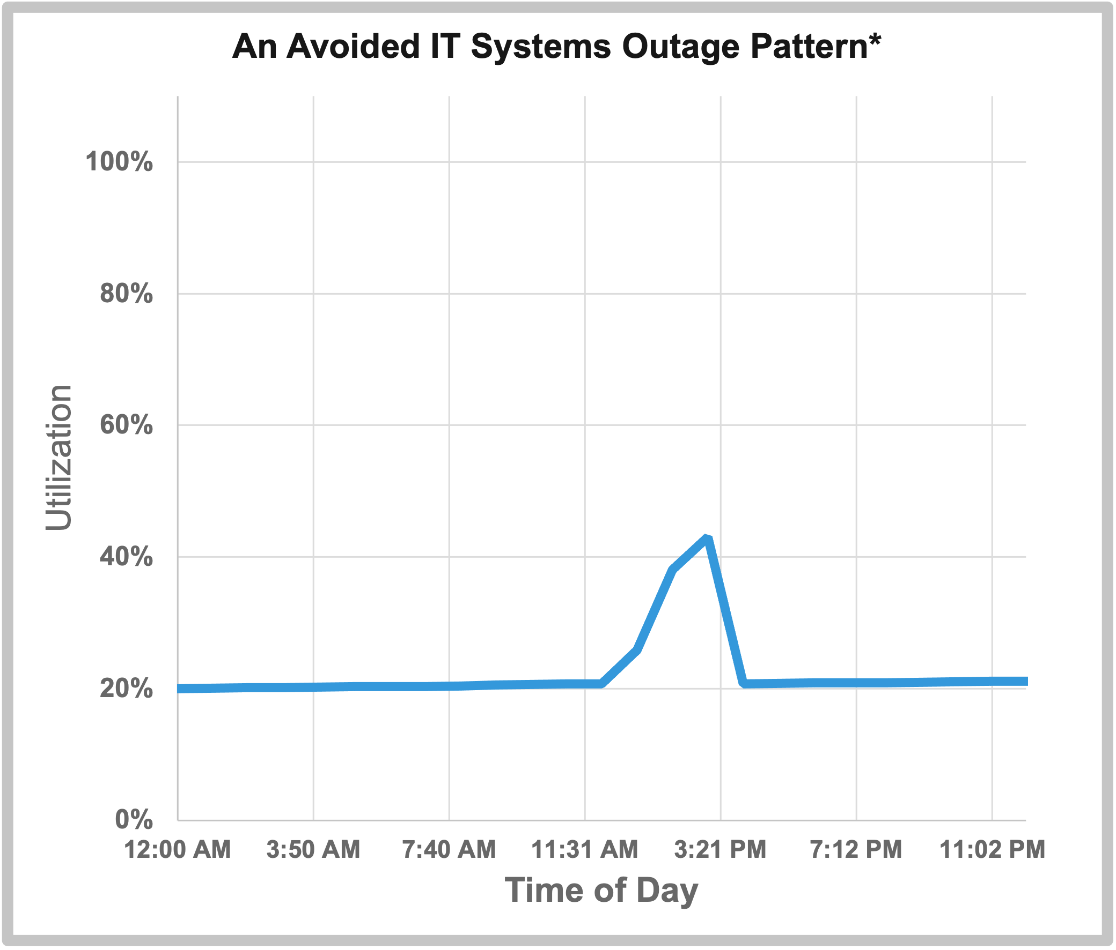
AIOps Enabled Approach
Fabricated Outage Timeline
11:30AM:
change deployed to production
2:30PM:
AIOps system anomaly detection identifies unusual resource utilization spike
3:15PM:
Admin repairs resource overrun
5:00PM
Admin leaves work for the day
10:30PM
Admin goes to sleep
*Fabricated example – no admins were harmed in the making of this chart
Image Source: NASA / GSFC Ben Williams

Slide 47
AIOps Categories
Statistical Analysis
Correlation | Clustering
Classification
Natural Language Processing (NLP) &
Large Language Models (LLM)

Slide 48
AIOps: Statistical Analytics
Anomaly Detection
+
Outlier Detection
Regression Analysis
+
Trends, Forecasts, Predictions
Notes:
Examples:
- Anomaly Detection: cost consumption suddenly increased beyond normal levels
- Outlier Detection: average ingest rates are in normal levels, but [xyz] data product is 5x slower than the average
- Regression Analysis: storage consumption increasing linearly/exponentially – expected to reach capacity by [x] date

Slide 49
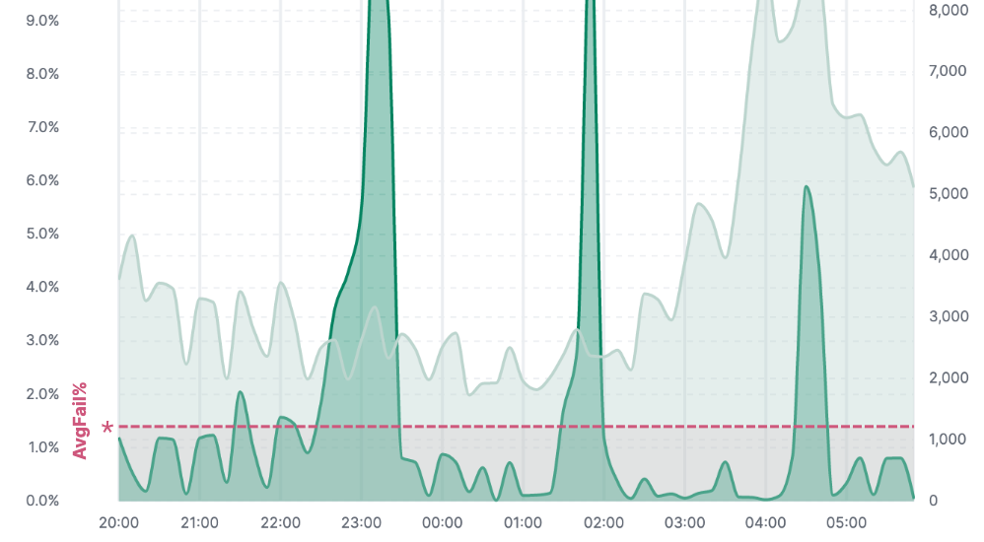
AIOps: Correlation | Clustering
Correlation help teams accelerate
root-cause analysis
  especially for inter-connected systems
Example: Cumulus Ingest Error Rates
Image Source: NASA / GSFC - ESDIS Cloud Metrics link (accessed controlled)

Slide 50
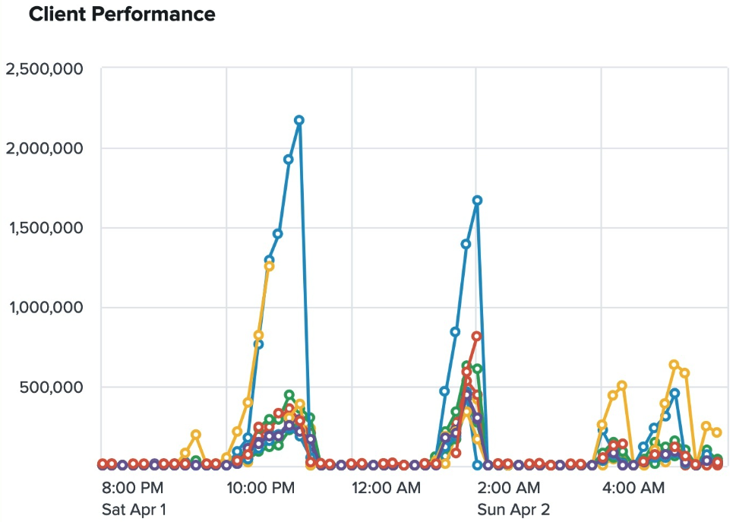

AIOps: Correlation | Clustering
Correlation help teams accelerate
root-cause analysis
  especially for inter-connected systems
Example: Cumulus Ingest Error Rates
Example: CMR Ingest & Search Performance
Image Source: NASA / GSFC - ESDIS Cloud Metrics link (accessed controlled)
Image Source: NASA / GSFC - ESDIS Degraded Service Events link (accessed controlled)

Slide 51
AIOps: Classification
Machine Learning to distinguish normal vs. abnormal behavior
  think credit card fraud detection and alerts
IT Systems Examples:
  Cost / Usage - is a surge in access:
    legitimate demand increase
    user error / infinite-loop
    denial of service attempt
  Cyber Security - are an admin’s actions:
    legitimate maintenance and sustainment
    indicative of an active hacking attempt
Uses supervised machine learning and requires high volumes of well labeled training data
  Several commercial observability and cyber security tools have
  pre-trained models to help identify likely malicious use

Slide 52
AIOps: NLP & LLMs
Service Desk Automation | Chatbots
Knowledge Base Management
Sentiment Analysis
Workforce Education

Slide 53
Where to Start
Robust logging from your applications
  Not just success / failure events
  As much application activity info as practical
Aggregate logs & metrics in analytics systems
  Numerous commercial and open-source options:
    CloudWatch, Grafana, ElasticSearch, Splunk, New Relic, etc.
Reduce reliance of pre-defined alert thresholds by augmenting with anomaly detection

Slide 54
Where to Start
Some words of caution:
  Avoid analysis paralysis of seeking normalized data schemas up-front
    Data normalization is a good thing, but it isn’t required to get started and to start seeing benefits
    Lots of current and emerging observability schemas. Ex:
      Elastic Common Schema (ECS)
      Splunk Common Information Model (CIM)
      OpenTelemetry
      Open Cybersecurity Schema Framework (OCSF)
  Data transformation is a good and normal part of AIOps
    When you start treating raw system logs as ”level-0” data, you open lots of analytic opportunities

Slide 55
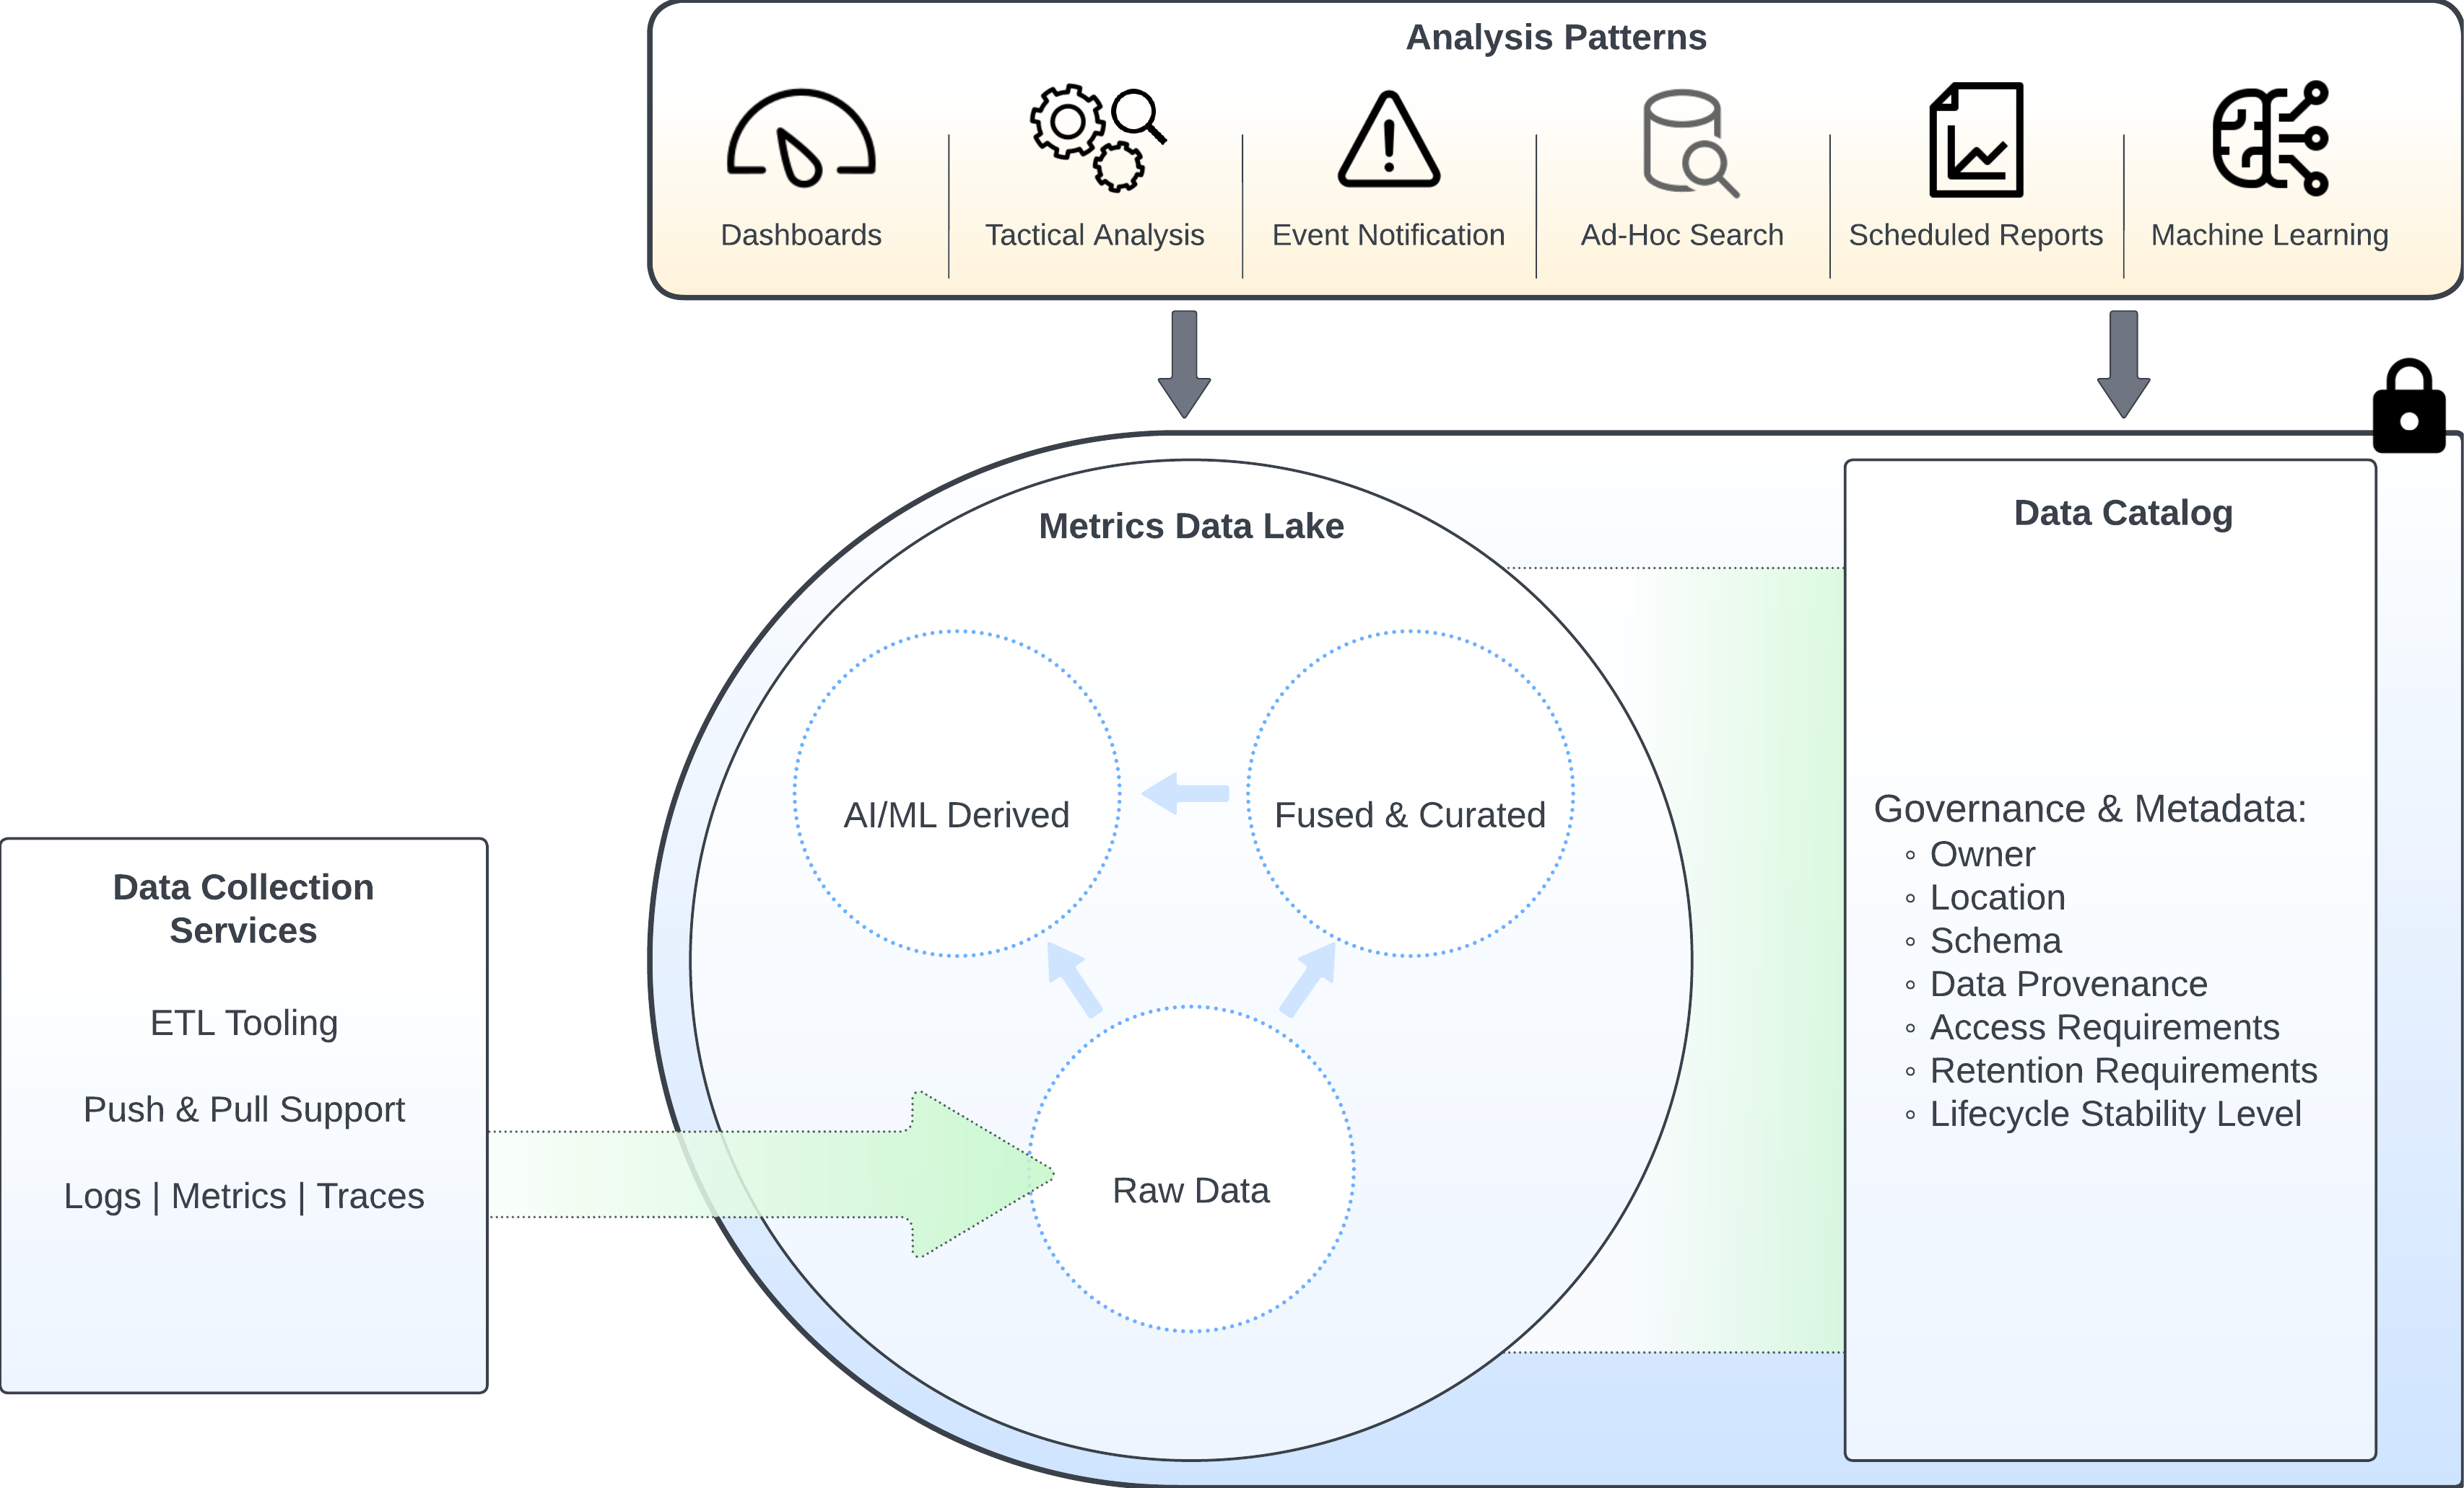
Scaling Up: Data Lake House
EOSDIS Data Lake House Architecture - (Draft)
Image Source: NASA / GSFC Ben Williams

Slide 56
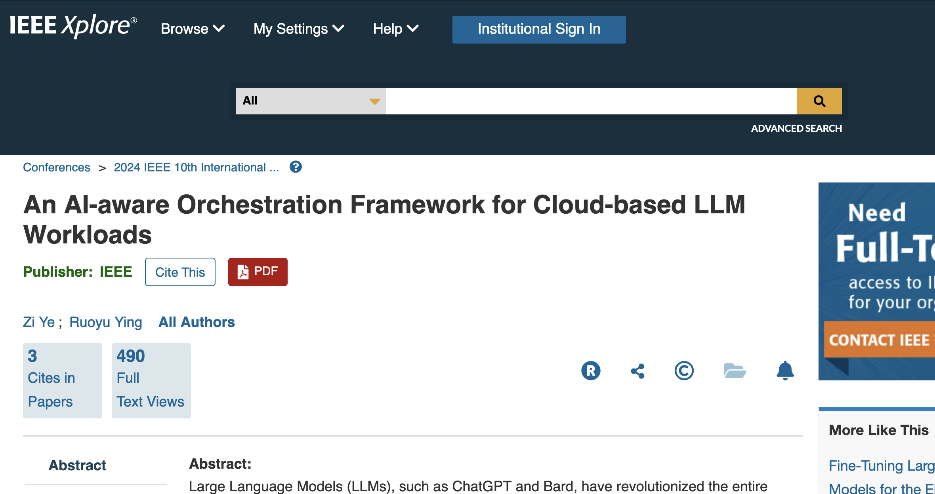

Slide 57
Questions?

